Slide 1
PREŠKOLENIE – Voltížne pravidlá SJF 27 Marec 2022

Slide 2
AGENDA
Nedeľa, 27 Marca 2022
17.00 Informácie o zmene v pravidlách a smerniciach SJF 2022
17:30 Informácie o zmene v pravidlách a smerniaciach FEI 2022
Počítanie cvalových skokov
18:45 Záver

Slide 3
SVK – všeobecné informácie
Voltížne pravidlá platné od 1.4.2022
Smernica pre rozhodcov platné od 1.4.2022
Všeobecné pravidlá platné od 1.3.2022
Zloženie SVK od roku 2022
Laura Lenčéšová - Predsedkyňa SVK
Členovia: Katka Kubišová, Martin Necela, Jan Tribula, Andrea Barci

Slide 4
SVK – všeobecné informácie
Lonžérska skúška - na spôsobilosť lonžéra lonžovať na pretekoch SJF je potrebné vlastniť trénerskú licenciu (iba lonžérska skúška, na základe predpisov SJF, nie je dostatočné dosiahnuté vzdelanie)
Kódex reprezentanta bod 2 - Zákaz nosiť národný znak na národných pretekoch. Po diskusiii s predsedníctvom SJF, je nutné tak ako aj v iných disciplínach na národných pretekoch, prekryť národný znak na dresoch, poduškách a akejkoľvek inej výstroji kusom látky, páskou alebo pod.
Prechod medzi kategóriami – na národných pretekoch (SVP+MSR) jednotlivec nesmie prestupovať z vyššej kategórie do nižžšej.

Slide 5
SVK – všeobecné informácie
Skupina D1 povinná zostava – nestopuje sa čas povinnej zostavy na základe zápisnice zasadnutia komisie z roku 2013
Rozpis - usporiadatelia pretekov sú povinní predložiť schvaľovateľovi rozpis pretekov na schválenie minimálne 4 týždne pred ich konaním.
Rozhodcovský zbor: Na národných pretekoch v rozhodcovskom zbore musí byť nadpolovičný počet členov s rozhodcovskou licenciou SJF. Predseda rozhodcovského zboru musí byť zo zoznamu národných rozhodcov SJF .
Na SVP sa rozhoduje v počte minimálne 3 rozhodcovia
Na MSR sa rozhoduje v počete minimálne 4 rozhodcovia (zmena, doteraz bolo minimálne 6)

Slide 6
SVK – všeobecné informácie
Štartové možnosti: v ľubovoľnej kategórií (mimo mladších detí) môže jednotlivec, dvojica, skupina pretekať súčasne na dvoch koňoch, pričom jeden kôň je považovaný za nového koňa (to znamená v 1.sezóne od svojho prvého štartu).
Nový kôň - duplicitný štart - môže štartovať iba v jednej z týchto súťaží, mimo MSR.
Do SVP sa pretekárovi započíta iba jeden, lepší výsledok.

Slide 7
SVK – všeobecné informácie
Losovanie - Na národných pretekoch (MSR a SVP) sa môže organizátor rozhodnúť, či štartovné listiny pripraví dopredu bez losovania alebo bude losovať.
V prípade, že zostaví štartovné listiny dopredu bez losovania, musí zohľadniť pripomienky (premadlovanie, lonžovanie viacerých koní ) uvedené v prihláške.
Po termíne definitívnych prihlášok organizátor rozpošle štartovné listiny k nahliadnutiu klubom a v prípade opodstatnených pripomienok štartovnú listinu upraví.

Slide 8
SVK – všeobecné informácie
Spôsobilosť koňa MSR – o spôsobilosti koňa zúčastniť sa v preteku rozhoduje predseda rozhodcovského zboru na základe odporúčania veterinárneho delegáta v súlade s postupom uvedeným vo Veterinárnych pravidlách.
Konzultácie známok: Konzultácie udelených známok s členmi rozhodcovského zboru môže konzultovať iba tréner, organizátor preteku alebo výpočtové stredisko a to počas prestávok preteku

Slide 9
Voltížne pravidlá a smernica SJF
Mladí jazdci
vek 16 – 21
Povinná zostava, Technická zostava a voľná zostava
V Technickej zostave sa hodnotia iba prvé 3 technické cviky.
Limit 1 minúta
Senior jednotlivec
vek 16 (zmena pôvodne bolo 15r)

Slide 10
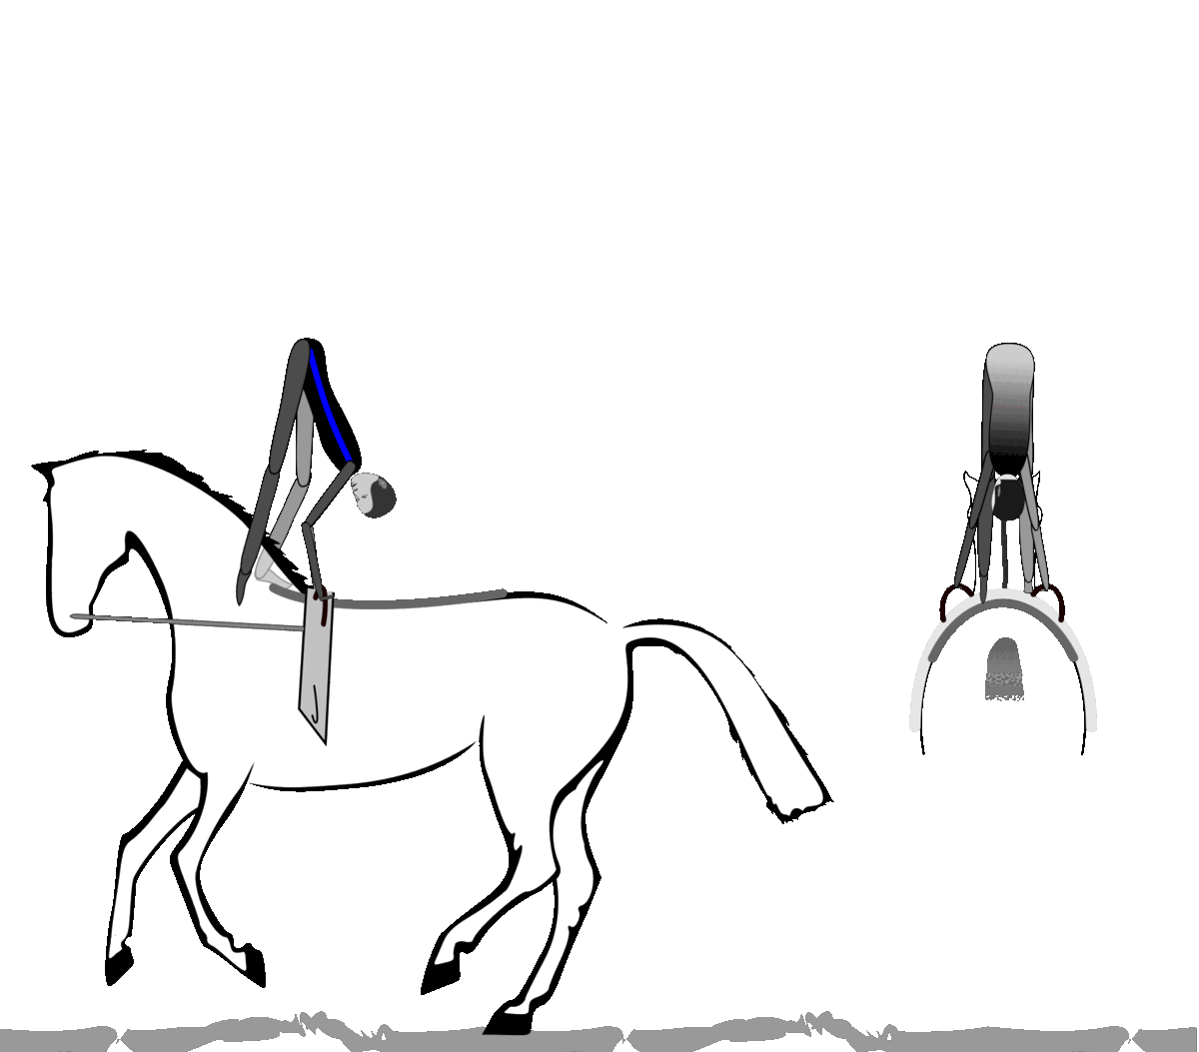
Nový technický cvik – Premet bokom z krku na chrbát koňa (Mlynské kolo)

Slide 11
Mlynské kolo
1. energetická fáza začína v kontra stoji na krku na jednej nohe, ruky sú na vrchu madiel
2. fáza stúpania začína, keď sa oporná noha odrazí od krku
3. fáza klesania začína klesaním prvej (našvihávajúcej) nohy
4. fáza dopadu začína dotykom chrbta koňa chodidlom prvej nohy

Slide 12
Mlynské kolo
Kedy cvik začal?
aby sme vedeli určiť či sa udeje opakovanie cviku
Ukončil sa cvik správne?
aby sme vedeli určiť či je za cvik 0
Bolo ťažisko tela v správnej polohe?
Bol predvené premet v súlade s mechanikou?
Bola vzdialenosť nôh konzistentná?
aby sme vedeli určiť správnu referenčnú známku

Slide 13
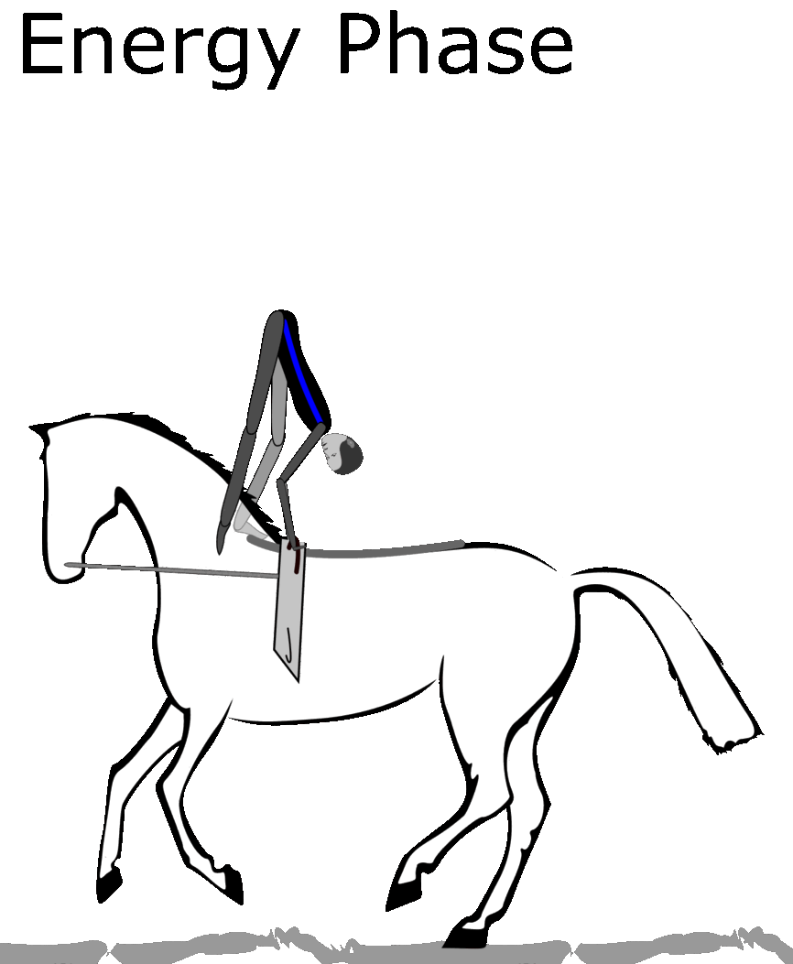

Slide 14
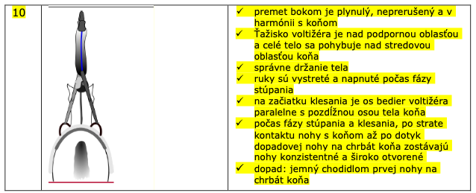

Slide 15
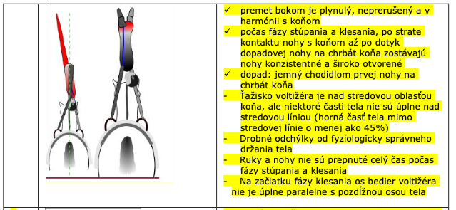
8

Slide 16
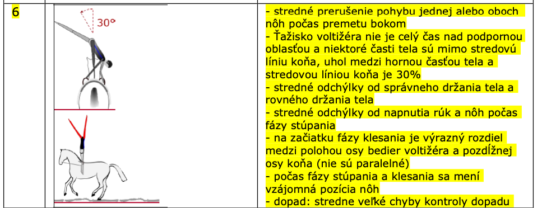

Slide 17
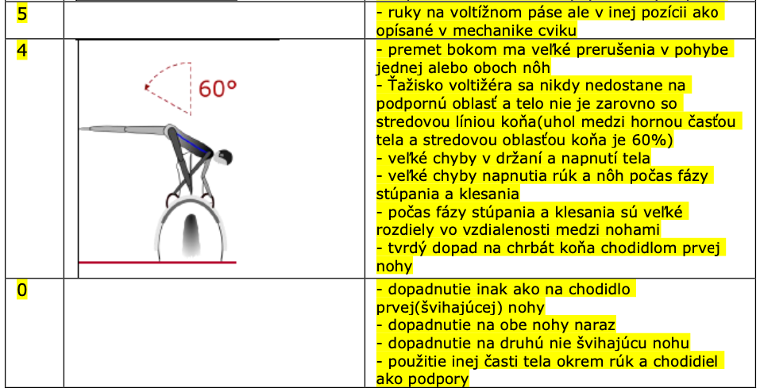

Slide 18
Referenčná známka – použitie
Identifikácia boxu referenčnej známky
Box referenčnej známky je 1 bod
Používame desatiny
Minusy v referenčnom boxe nás navedú na vybratie správnej referenčnej známky
Rozhodca sa rozhodne o desatinách
Referenčná známka je vybratá bez ohľadu či cvičenec predvedie jeden alebo viacero “mínusov” v referenčnej známke.
K určenej známke pridáme zrážky za špecifikcé chyby (napr. Chýbajúci cvalový skok)
Plus má rozhodca možnosť strhnúť maximálne do výšky 1 bodu za prípadné ďalšie chyby, ktoré nesúvisia priamo s podstatou cviku (špičky, pokrčené kolená a pod)

Slide 19
Mlynské kolo
Ukážky
https://docs.google.com/presentation/d/1Yr9pAqIFsd4iwQFmDjLAqfaxduX-lUNhT2XLeA9Vq1g/edit#slide=id.g11923b75fa5_0_2

Slide 20
FEI MAIN RULE CHANGES 2022 –

Slide 21
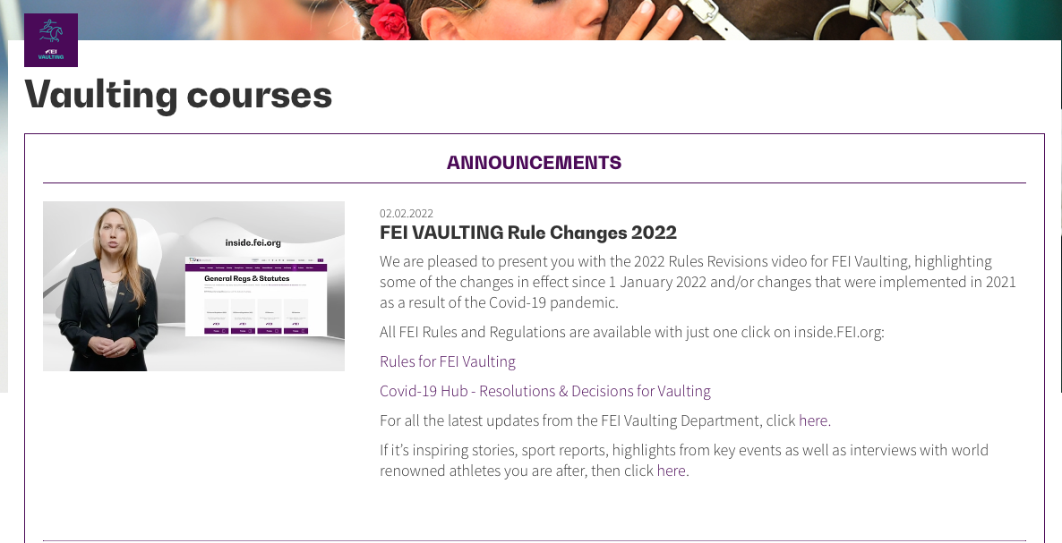
RULES 2022 – FEI video
https://campus.fei.org/course/index.php?categoryid=10

Slide 22
Forum 2022
https://inside.fei.org/fei/disc/vaulting/forums/2022

Slide 23
General
Events and Competitions
1.2. Male and Female Individual Vaulters may be classified together at 1* level and must be classified separately in all other levels.

Slide 24
Senior Championships – Nations Team
 | Pas-de-Deux | Individual Male & Female | Squad | Official Team
Day 1 |  | Round 1 - Compulsory Test Open to all Starting order: Draw | Round 1 - Compulsory Test Open to all Squads, 1 per Nation Starting order: draw
Day 2 | Round 1 - Free Test Open to all PdD Starting order: Draw | Round 1 - Technical Test Open to All Starting order: Reverse order of ranking Round 1-Compulsory
Day 3 |  | Final - Free Test Open to All Starting order: Reverse order of ranking Round 1 | Final - Free Test open to all Squads Starting order: reverse order of rankings Round 1 | Declaration of Teams
 |  | Medals | Medals
Day 4 | Final - Free Test Number: 15 Starting order: reverse order of ranking Round 1 |  |  | Final - Free Test Number: 8 Starting order
 | Medals |  |  | Medals

Slide 25
Senior Championships – Nations Team
Declaration of the Official Team Competition:
The Chefs d'équipe must declare the names of the Squad, Individual 1 and Individual 2 to the show office, at the latest one hour after the last relevant Test.
Starting order Official team competition members at Championships:
Individual 1 of each Team: the Individual 1 from the last placed Team starts first, followed by the Individual 1 of the second last placed Team and so on,
Individual 2 of each Team: same order of go as for Individual 1, the Squad of each Team: same order of go as for Individual 1

Slide 26
Juniors Championships
Championships Individual Competition Junior Male and Female | Round 1 |  | Qualification for Final
 | Test 1 | Test 2 |  | Final
 | Individual Comp Test | Individual Free Test | Best 20 Individuals | Individual Free Test
Championships Squad Competition Junior | Round 1 |  | Qualification for the final | Final
 | Test 1 | Test 2
 | Squad Comp Test | Squad Free Test | 15 best Squads | Squad Free Test
Championships Pas-de-Deux Competition Junior | Round 1 | Qualification for the final | Final
 | Test 1
 | PdD Free Test | 15 best Pas-de-Deux | PdD Free Test

Slide 27
Young Vaulters Championships
Held with Junior Championships
Championships Individual Competition Young Vaulter Male and Female | Round 1 |  | Qualification for Final | Final
 | Test 1 | Test 2
 | Individual Comp Test | Individual Young Vaulter Tech Test | Open to All | Individual Free Test

Slide 28
Scoring - calculation of the scores
Calculation of scores in a Round:
for each round with more than one test, the scores of all tests are added and divided by the number of tests.
Example:
Individual CVI3*/CVIY2*: Compulsory + Tech Test + Free Test = Score/3

Slide 29
Scoring - calculation of the scores
Calculation of the end score:
If the first Round comprises more than one Test, the total Final score will be calculated with a ratio of 50% for the first Round and a ratio of 50% for the Final (one Test).
Example:
Individual Championships class first round: Compulsory + Tech Test = Score/2 = 50% of the final score
Individual Championships class second round round: Free Test = 50% of the final score

Slide 30
Scoring - calculation of the scores
Calculation of the end score:
If the first Round comprises only one Test, the total Final score will be calculated with a ratio of 40% for the result of the first Round (one Test) and a ratio of 60% for the result of the Final (one Test).
Example:
Senior Squad Championships class first round:
Compulsory 40% of the final score
Senior Squad Championships class second round:
Free Test 60% of the final score

Slide 31
Starting possibilities
A Vaulter may only compete in either the Senior Championship or in a Youth Championships (Juniors or Young Vaulters) in any calendar year.
However, and notwithstanding anything to the contrary in the GRs, a Vaulter competing in a Junior Individual Championship competition or a Young Vaulters Championship may compete in a Senior Squad Championship Competition in the same calendar year (this possibility is the only exception to the rule).
When Youth and Senior Championships are held concurrently, such Vaulter may only compete in two Competitions in total.
When Youth and Senior Championships are held separately, the participation of such Vaulter in the Senior Championships is strictly limited to the Squad of his/her Nation.

Slide 32
Entries per NF at the Championships
NF may enter additional Pas-de Deux with 2 vaulters, plus 1 reserve Horse and 1 reserve Lunger.
Increasing number of Grooms to 1 Groom per Horse.

Slide 33
Substitution
At Championships, a Pas-de-Deux may be substituded by the reserve Pas-de-Deux up to one hour before the beginning of the first test of the Competition

Slide 34
HORSE BLOOD RULE
The Judge at A may eliminate an Athlete and/or Horse in the following cases:
If the Judge at A suspects fresh blood anywhere on the Horse during the test, he will stop the Horse to check for blood. If the Horse shows fresh blood, it will be eliminated. The elimination is final. If the Judge through examination clarifies that the Horse has no fresh blood, the Horse may resume and finish its test.
If the FEI Steward discovers fresh blood in the Horse’s mouth during the check at the end of the test (Article 719.4), he/she informs the Judge at A, who will eliminate the Competitive Unit.

Slide 35
HORSE BLOOD RULE
The Judge at A may eliminate an Athlete and/or Horse in the following cases:
If the FEI Steward discovers fresh blood anywhere else on the Horse’s body (i.e. other than the Horse’s mouth) during the check at the end of the test, the Competitive Unit is not automatically eliminated. The FEI Chief Steward shall inform the Judge at A whether the Horse is fit to continue in following competition(s) in the Event. The Judge at A will take a decision on the Horse’s fitness to continue, based on the FEI Veterinarian’s advice. If the Judge at A decides the Horse is not fit to continue, the Horse will not be permitted to take part in any further Competition(s) or tests at the Event, but the result(s) obtained by the Competitive Unit in any Competition(s) or tests already completed shall stand

Slide 36
HORSE BLOOD RULE
The Judge at A may eliminate an Athlete and/or Horse in the following cases:
If the Horse is eliminated pursuant to the above, or if the Horse is injured during the test and starts bleeding after finishing the test, it should be examined by an FEI Veterinarian prior to the next Competition to determine if it is fit to continue in the Event the following day(s). The decision of the FEI Veterinarian is not subject to appeal.
Fall of a Horse. The Horse must be considered fit to continue in the event by the FEI Veterinary Delegate, before it may be permitted to take part in a next round or Competition.

Slide 37
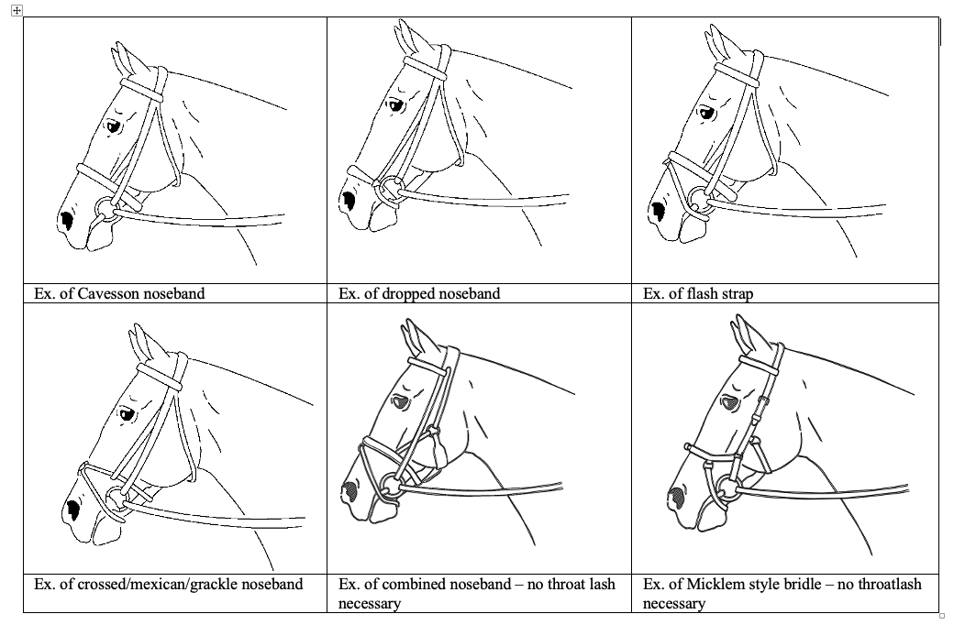
Vaulting Horse - Equipment
Bridle with nose band

Slide 38
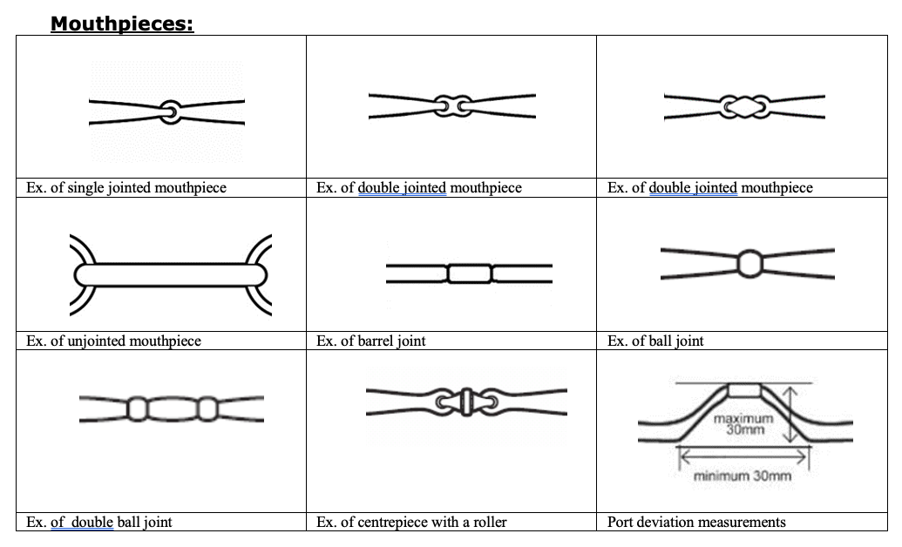
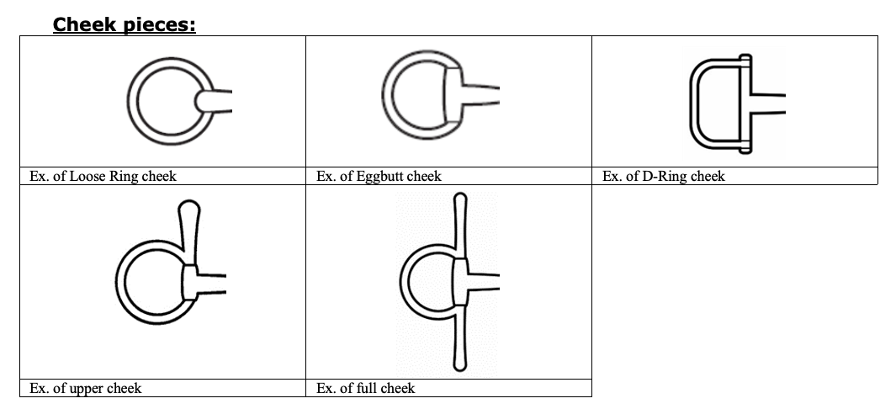
Vaulting Horse - Equipment
Snaffle bit

Slide 39
Vaulting Horse - Equipment
2.7. Bandages and/or brushing/overreach boots are optional. Hoofboots are authorised.
2.8. Earhoods and plugs are permitted for all Events and may also provide noise reduction and must allow the ears to move freely. Ear hoods must not cover the horse’s eyes. The ear hoods should be discreet in colour and design. Ear hoods may not be attached to the noseband
2.12. The Lunger must use a lunging whip.

Slide 40
Vaulting Horse - Equipment
3. Equipment check. A visual check before leaving the last warm up arena may be conducted by the Stewards to prevent Athletes going into the Competition arena with any forbidden equipment. A visual check can be declined, as it is designed to help Athletes but is not compulsory. However, it remains the full responsibility of the Athlete not to enter with any forbidden piece of Equipment.

Slide 41
Vaulting Horse - Equipment
4. A Steward must be appointed to check the equipment of each Horse immediately after it leaves the arena. Any discrepancy will be reported to the Judge at A and result in immediate Elimination if confirmed. The checking of the bridle must be done with the greatest caution, as some Horses are very sensitive about their mouths (see FEI Steward’s Manual). The Steward must use disposable surgical/protective gloves when checking the bridle (one - 1- pair of gloves per Horse).

Slide 42
Vaulting Horse - Equipment
5. At the WARM-UP arena :
Lunge rein must be attached to the inner ring of the bit or to the lunge caverson.
Double lunge/long reining is allowed, when the lunge is attached in a way that it is only being used as a long rein (attached to the ring of the bit. A double lunge may not be used as a draw rein.

Slide 43
Vaulting Horse - Equipment
Identification number:
7.1. Each Horse keeps the same identification number provided by the Athlete/PR on arrival throughout the Event.
7.2. Failure to display this number incurs firstly a warning and, in the case of a repeated offence, a fine imposed on the PR (Person Responsible) by the Ground Jury.
7.3. The identification numbers shall be discreet on white background, the colour of the numbers may vary.

Slide 44
OFFICIALS
Stars vs. Levels:
To harmonize our rules with the Education program for all judges.
FEI Judge Level 1 – new Level of judge replace national judges
FEI Judge 2* = FEI Judge Level 2
FEI Judge 3* = FEI Judge Level 3 and so on
Stewards also have a Level instead of Start but there levels are one up compering stars:
FEI Steward 3* = FEL Steward Level 4
FEI Steward 2* = FEI Steward Level 3

Slide 45
GUIDELINES 2022

Slide 46
Guidelines 2022
Reworked structure of the Guidelines
Judging system that consisted of setting up a score using a Reference score and General deductions (1st phase free test + Cartwheel movement from back to neck) was introduced
Nothing else was changed
Horse score remain untouched
Compulsory exercises remain untouched (for 2022)
Free test - Artistic/Degree of Difficulty remain untouched
Technical Test exercises (4 remaining) remain untouched (for 2022)
Annex II – Compulsory exercises valid as of 2023 using the methodology to evaluate exercises using the Reference score system.

Slide 47
RULE/GUIDELINES changes 2023

Slide 48
GUIDELINES changes as of 2023
Rework 4 remaining technical exercises
Kneeling forward to Stand Backwards
Lower Arm Stand
Mount to Reverse Shoulder Stand
Stand Split Backwards
Implement Compulsory exercises (Annex II of 2022 Guidelines)
If rule change of Free test concept will be implemented in the rules it will influence the Guidelines too

Slide 49
RULE changes as of 2023? NEW scoring system of the Free Test
As of 1 January 2022, the FEI can, with the prior agreement of the relevant Organising Committee, test a new scoring system on a trial basis at selected events, it being understood and agreed that the new scoring system will not be used to calculate the official results.
The details/explanation of the new scoring system will be published on the Vaulting page of inside.fei.org. The FEI, in consultation with the FEI Vaulting Committee, can make revisions to the new scoring system from time to time provided that any changes must also be published on the Vaulting page.
If the FEI Vaulting Committee and the FEI decides that the trial of the new scoring system has been successful, it will be proposed for inclusion in the FEI Vaulting Rules 2023.

Slide 50
THANK YOU
pavla.krauspe@gmail.com
Notes:
And this is the end, of my presentation of course. Thank you for your attention.
I you have any questions to the rules, please paste them in to the chat or you can also send them to my email…We will answer them today at the end after the Guidelines session or tomorrow at the Rule/Guidelines session.

