Slide 1
Umelecký dojem
Oct 21, 2022
Pavla Krauspe, 25.02.2024

Slide 2
Agenda
Introduction
CoH Consideration of the Horse Individuals, Squads, PDD
C1 Variety of Exercises Individuals, Squads, PDD
C2 Variety of Positions Individuals, Squads, PDD
C3 Unity of Composition Individuals, Squads, PDD

Slide 3
INTRODUCTION
Reasoning behind:
Urgent need to emphasize the wellbeing of the horse as part of the package changes for 2024
Shortening the free test of Squads, Qualification of horses/squad members, Limitation of triples, Assessment of trot round, Draw reins
Unclear guidance in C2 for Pas De deux and Squads
Extreme lack of any guidance in C3 in all competitions
VTC tasked Artistic Working Group to prepare:
Consideration of the Horse for all competition
C2 for Squad and Pas De Deux
C3 for all competition Thank you Artistic Working Group Members:
Jacques Ferrari (FRA)
Anita Flamand (SUI)
Stefan Csandl (AUT)
Alicen Divita (USA)
Pavla Krauspe (SVK) - as liaison between AW group and VTC

Slide 4
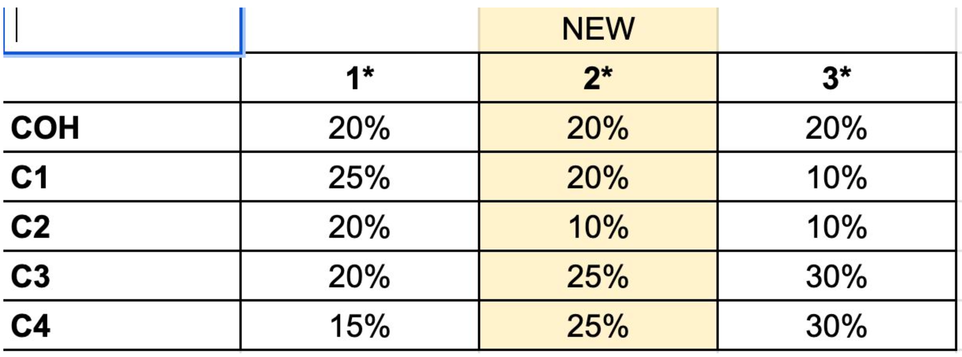
2024 Smernice – Voľná zostava - %

Slide 5
Zohľadnenie koňa
(CoH)
Rome
Oct 21, 2022

Slide 6
CoH - Zohľadnenie koňa, Harmónia s koňom
5.4.2. CoH
Zohľadnenie koňa a harmónia s koňom sa zaoberá partnerstvom medzi voltižérom a koňom.
Referenčná známka sa zaoberá tým, ako sa voltižér prispôsobuje úrovni tréningu a aktuálnemu fyzickému / mentálnemu / emocionálnemu stavu Koňa.
Pre skupiny: Ak sú zahrnuté trojice, odporúča sa, aby trojice nepresiahli viac ako 1/3 času voľnej zostavy.
4 kritéria rozhodovania :
Váha
Kompozícia
Rovnováha
Kontakt s koňom

Slide 7
CoH - Zohľadnenie koňa, Harmónia s koňom
CoH je momentálne iba vo voľnej zostave
CoH bude zahrnuté do umeleckého dojmu Technickej zostavy v 2025

Slide 8
CoH - Zohľadnenie koňa, Harmónia s koňom
Metodológia na základe pozorovania
Boxes Up to 2 / Up to 4 / Up to 6:
From 0 to Up to 6 : všetky 4 kritéria sú zasiahnuté (Rovnováha a kontakt) + (Váha a kompozícia)
< rozhodnutie medzi 0-6 je potrebné spraviť na základe vážnosti akou je kritérium zasiahnuté
Box Up to 8:
From 6.1 to Up to 8 : 3 hlavné kritéria sú sčasti zasiahnuté ((Rovnováha a kontakt) + (Váha ALEBO kompozícia)
< rozhodnutie je potrebné spraviť na základe vážnosti akou je kritérium zasiahnuté
Box Up to 10:
From 8.1 to Up to 8,9 : 3 hlavné kritéria sú zasiahnuté > (Balance and Contact)
< rozhodnutie je potrebné spraviť na základe vážnosti akou je kritérium zasiahnuté
From 9.0 to Up to 9.9 : 1 hlavné kritérium je zasiahnuté > (Rovnováha alebo Kontakt)
< rozhodnutie je potrebné spraviť na základe vážnosti akou je kritérium zasiahnuté
10 = všetky 4 kritériá sú dokonale naplnené

Slide 9
Updated text after Seminar in Salzburg

Slide 10
Updated text after Seminar in Salzburg

Slide 11
Updated text after Seminar in Salzburg

Slide 12
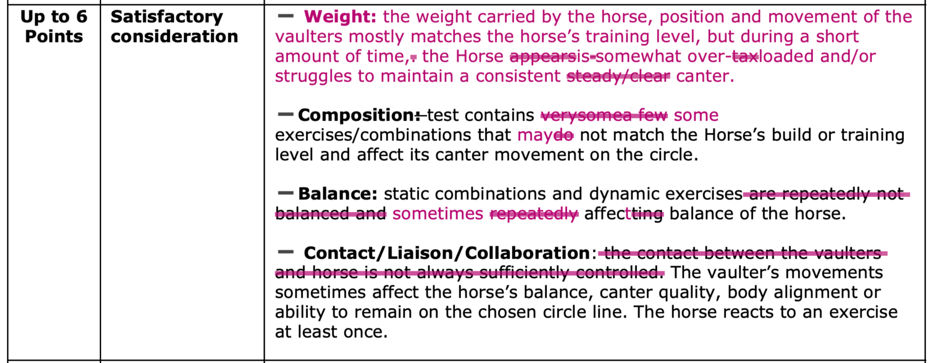
Updated text after Seminar in Salzburg

Slide 13
Updated text after Seminar in Salzburg

Slide 14
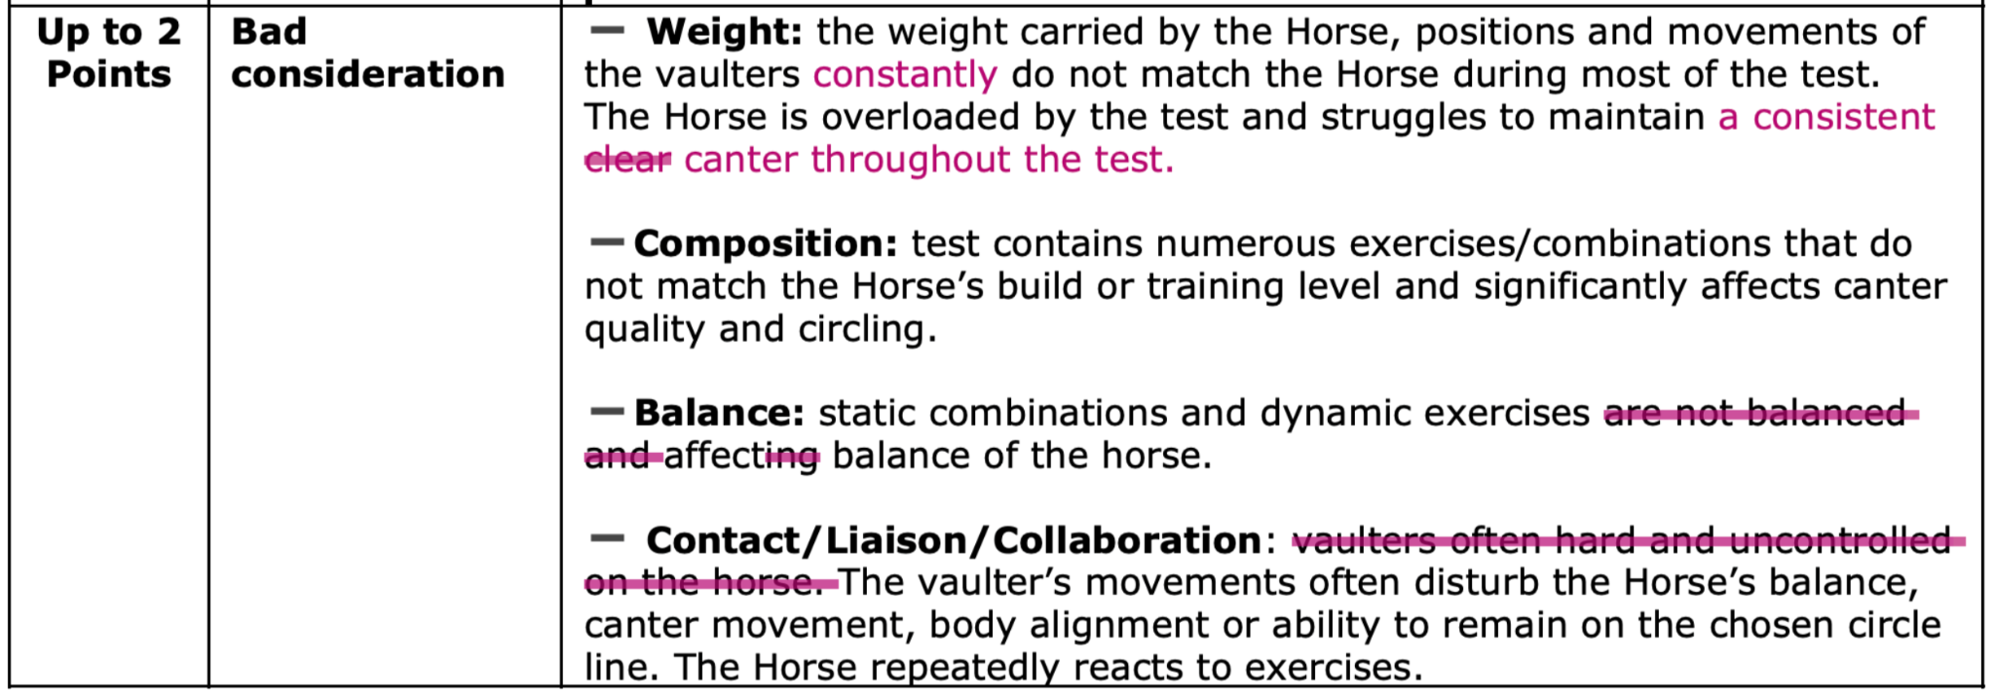
Updated text after Seminar in Salzburg

Slide 15
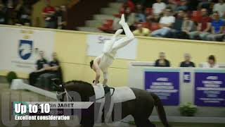
CoH- Individuals
Reference scores
Notes:
Pavla scores:
Up to 2 = 1,5
Up to 4 = 3 Up to 6 = 5,5
Upt to 8 = 7,5 - 7,8
Upt to 10 = 9,5

Slide 16
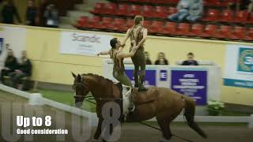
CoH- Pas de Deux
Reference scores
Notes:
Pavla scores:
Up to 4 = 3,0 Up to 6 = 6,0
Upt to 8 = 7,5
Upt to 10 = I don'’ agree…i would give them between 6 and 7…the horse many times showing heavy canter, mainly affected when stefan was in the loop or on the neck. The performance has great complexity and unity of composition but the horse is not chosen well to their performance, imho

Slide 17
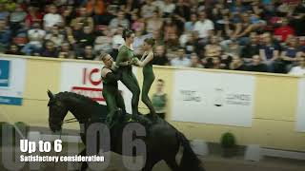
CoH- Squad
Reference scores
Notes:
Up to 4 = 3,5 Up to 6
Upt to 8 = 8,0
Upt to 10 = 9,0 - 9,5

Slide 18
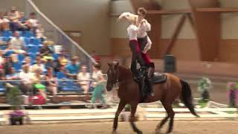
CoH- Scoring Test
MIXED competitions - Ind, Squad,
Notes:
Oceania: 8,5
Squad RUS: 4,0
PDD: 7,5

Slide 19
Variety of Exercises - C1

Slide 20
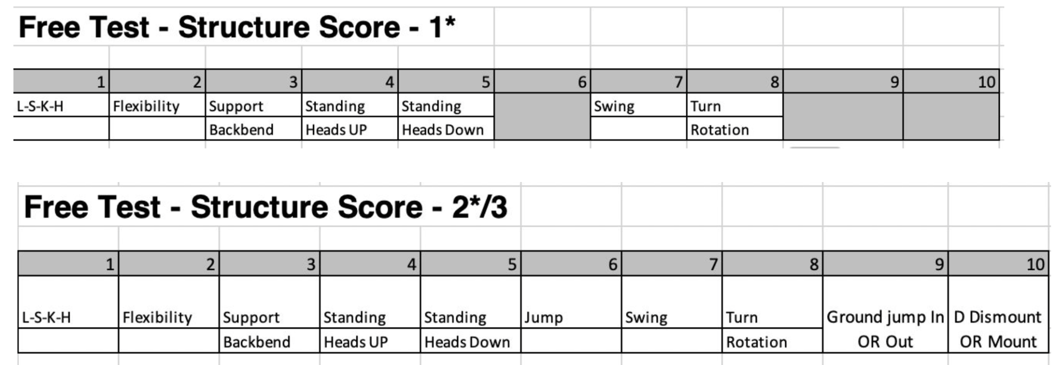
C1 – Jednotlivci/Skupiny a Dvojice
Iba jeden cvik v kazdej skupine je potrebné predviesť
Structure groups are included in the scorsheets. The boxes are implemented in the Scoresheets for Individuals only.
It is NOT MANDATORY for judge to fill the boxes. ONLY RECOMMENDED.

Slide 21
C1 - Variety of Exercises for Individual (CRITERIA)
Variety of Position (Test sen/jun 1*, Test Children 1*/2*)
A ratio between static and dynamic exercises.
Selection of exercises, positions and transitions from different structure groups.
(5.4.3 - ground jumps from outside are not required)*
*Feedback from NFs - to let the athletes decide from which side they want to perform the one required ground jump.
Variety of Position (Test sen/jun 2*, Test sen 3*)
A ratio between static and dynamic exercises.
Selection of exercises, positions and transitions from different structure groups.
Feedback proposal to add (to keep the same logic for every category?
(5.4.3 - ground jumps from outside are not required)*

Slide 22
Variety of Exercises - C1
Skupiny/Dvojice

Slide 23
C1 –Cviky Dvojice
S oporou Dvojité podporné cvičenia: Jeden voltižér podopiera celú váhu druhého voltižéra
Stabilizované Dvojité stabilizované cvičenie: jeden voltižér stabilizuje a/alebo čiastočne podporuje váhu svojho partnera, aby ho vyvážil alebo podoprel.
Kombinované Dvojité kombinované cvičenia: Dvaja voltižéri súčasne predvádzajú samostatné cvičenia jednotlivca (dve statické cvičenia/ jedno statické a jedno dynamické cvičenie) bez vzájomnej podpory alebo iba s minimom vzájomnej podpory.
Kombinované dynamické cvičenia Dve dynamické cvičenia vykonávané súčasne

Slide 24
C1 – CVIKY SKUPINY
Jednotlivé
Cvičenia jednotlivca: iba jeden voltižér na koni
S oporou
Dvojité podporné cvičenia: Jeden voltižér podopiera celú váhu druhého voltižéra
ALEBO
Trojité podporné cvičenia: Jeden (alebo dvaja) voltižéri výrazne podopierajú celú váhu tretieho voltižéra (letec); ak jeden voltižér nesie celú váhu letca, tento voltižér
je podporovaný alebo stabilizovaný „stabilizačnou základňou“.
Stabilizované
Dvojité stabilizované cvičenie: jeden voltižér stabilizuje a/alebo čiastočne podporuje váhu druhého voltižéra, aby ho vyvážil alebo podoprel.
Kombinované
Dvojité kombinované cvičenia: Dvaja voltižéri súčasne predvádzajú samostatné cvičenia jednotlivca (dve statické cvičenia/ jedno statické a jedno dynamické cvičenie) bez vzájomnej podpory alebo iba s minimom vzájomnej podpory.
ALEBO
Trojité kombinované cvičenia: tri samostatné cvičenia jednotlivcov vykonávané súčasne, pričom váha žiadneho z voltižérov nie je alebo je len málo podporovaná ostatnými. (Aspoň jedno statické cvičenie)
ALEBO
Trojité polo-kombinované cvičenie: podporované dvojité cvičenie v kombinácii
s jedným samostatným cvičením jednotlivca
Kombinované dynamické cvičenia
Dve (alebo tri) dynamické cvičenia vykonávané súčasne

Slide 25
C1 – CVIKY SKUPINY
Jednotlivé
Cvičenia jednotlivca: iba jeden voltižér na koni
S oporou
Dvojité podporné cvičenia: Jeden voltižér podopiera celú váhu druhého voltižéra
ALEBO
Trojité podporné cvičenia: Jeden (alebo dvaja) voltižéri výrazne podopierajú celú váhu tretieho voltižéra (letec); ak jeden voltižér nesie celú váhu letca, tento voltižér
je podporovaný alebo stabilizovaný „stabilizačnou základňou“.
Stabilizované
Dvojité stabilizované cvičenie: jeden voltižér stabilizuje a/alebo čiastočne podporuje váhu druhého voltižéra, aby ho vyvážil alebo podoprel.
Kombinované
Dvojité kombinované cvičenia: Dvaja voltižéri súčasne predvádzajú samostatné cvičenia jednotlivca (dve statické cvičenia/ jedno statické a jedno dynamické cvičenie) bez vzájomnej podpory alebo iba s minimom vzájomnej podpory.
ALEBO
Trojité kombinované cvičenia: tri samostatné cvičenia jednotlivcov vykonávané súčasne, pričom váha žiadneho z voltižérov nie je alebo je len málo podporovaná ostatnými. (Aspoň jedno statické cvičenie)
ALEBO
Trojité polo-kombinované cvičenie: podporované dvojité cvičenie v kombinácii
s jedným samostatným cvičením jednotlivca
Kombinované dynamické cvičenia
Dve (alebo tri) dynamické cvičenia vykonávané súčasne

Slide 26
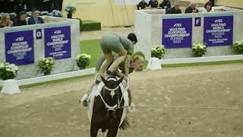
C1 -COMBINATIONS
Type of combinations video

Slide 27
Variety of Positions - C2
Skupiny/Dvojice

Slide 28
C2 - ROLE - Dvojice/Skupiny
Podporný voltižér: zdvíha celú váhu iného voltižéra.
Stabilizačný voltižér: pomáha zastabilizovať rovnováhu podpornému voltižérovi (len skupiny) alebo asistovanému voltižérovi.
Asistovaný voltižér: je podporovaný stabilizujúcim voltižérom, ktorý pomáha asistovanému voltižérovi udržať rovnováhu, ale nepodporuje celú jeho váhu (iba jej časť).
Letec (flyer): voltižér, ktorý je zdvíhaný iným/inými voltižérmi
Jednotlivec: predvádza individuálne cvičenie bez asistencie/stabilizácie iným voltižérom.

Slide 29
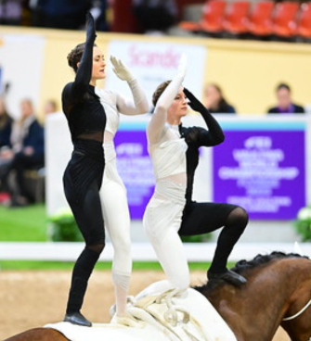
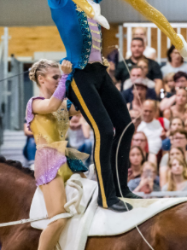
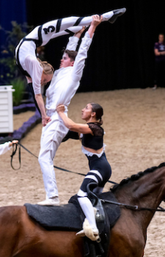
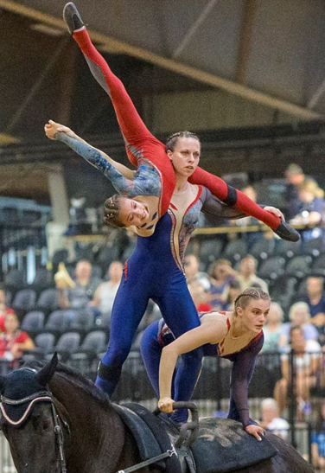
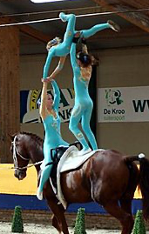
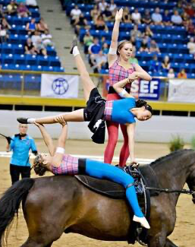
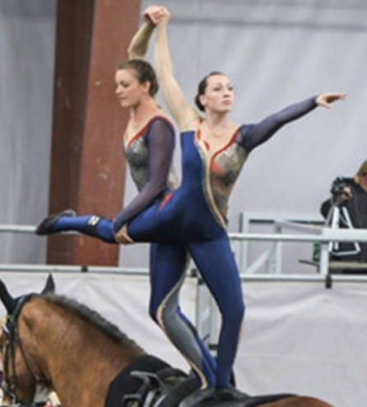
C2 - ROLES - Squad/Pas de Deux
Flyer
Supporting base
Stabilizing Vaulter
Individual
Assisted Vaulter

Slide 30
C1 – Skupiny/Dvojice - ÚROVNE
Articles 5.4.6.C2 (ACTUAL LEVELS)

Slide 31
C1 – Skupiny/Dvojice - ÚROVNE
Vsetky kombinácie by mali byť zahrnuté v zostave, trojice nie sú povinné, preto na dosiahnutie požadovanýych kritérii stačia cviky jednotlivca a dvojice.
Nízka úroveň (low): Nízka úroveň: Stabilizujúci voltižéri *, Asistovaní Voltižéri* a samostatný voltižér v akejkoľvek polohe v kontakte s koňom.
Def: Všetci voltižéri sú v kontakte s koňom / poduškou / pásom v ľubovoľnej polohe (ležmo až stojmo) počas cvičení jednotlivca, dvojíc a trojíc.
Stredná úroveň** (medium): Podporný voltižér v pozícii > lavičky (nízko a vysoko), kľačmo (madlá, slučky, poduška a pod.), stoja (v slučke/ách) + „letec“.
Def.: Stredná úroveň Je definovaná polohami podporného voltižéra počas dvíhania v kľaku, v polohe lavičky (nízka/vysoká úroveň), v stoji v slučke (slučkách) a v podobných polohách. Zdvíhaný voltižér (letec) nie je v kontakte s koňom (nezáleží na tom, ako vysoko je Letec zdvihnutý).
Vyššia úroveň (upper): Vyššia úroveň: Podporný voltižér*** > vo vzpriamenej polohe v stoji + letec (bod kontaktu a ťažisko alebo hod) nie je úplne nad hlavou
Def.: Je definovaná pozíciou podporného voltižéra v stoji počas zdvíhania. Zdvíhaný voltižér (letec) nie je v kontakte s koňom a nie je nad hlavou podporného voltižéra.
Letecká úroveň (aerial): Letecká úroveň: Podporný voltižér > vo vzpriamenej polohe v stoji + Letec (bod kontaktu a ťažisko alebo hod) úplne nad hlavou.
Def: Pri každom pohybe, pri ktorom je celé telo letca vyššie ako hlava podporného voltižéra. Príklady: Statické alebo dynamické cvičenia letca na podpornom voltižérovi vo vzpriamenom stoji, pri ktorom je telo letca vyššie ako hlava podporného voltižéra.
Výnimky z úrovní:
* Asistované skoky so stabilizujúcim voltižérom, ktorý je nižšie ako vzpriamený stoj, sú v nízkej úrovni, ak sa ťažisko asistovaného voltižéra nedostane vyššie ako hlava stabilizujúceho voltižéra. Ak ťažisko stúpne vyššie, bude sa považovať za strednú úroveň.
** V prípade, že stojky, stoje alebo hody vo vysokom držaní, pri ktorých ťažisko Letca presahuje nad úrovňou hlavy podporného voltižéra, zo strednej úrovne sa stáva vysoká.
*** Asistované skoky so stabilizujúcim voltižérom vo vzpriamenom stoji sú v hornej úrovni, ak sa ťažisko asistovaného voltižéra zdvihne nad hlavu stabilizujúceho voltižéra. Ak sa ťažisko zdvihne nižšie, považuje sa za strednú úroveň.
Notes:
Otvor smernice aukazuj v smerniciach a porovnavaj s anglickym textom

Slide 32
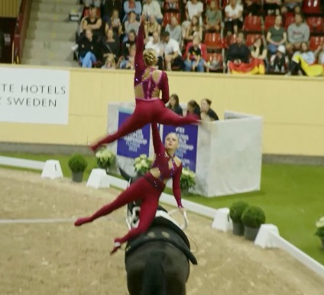
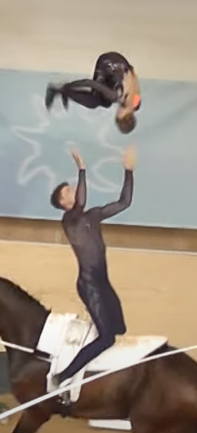
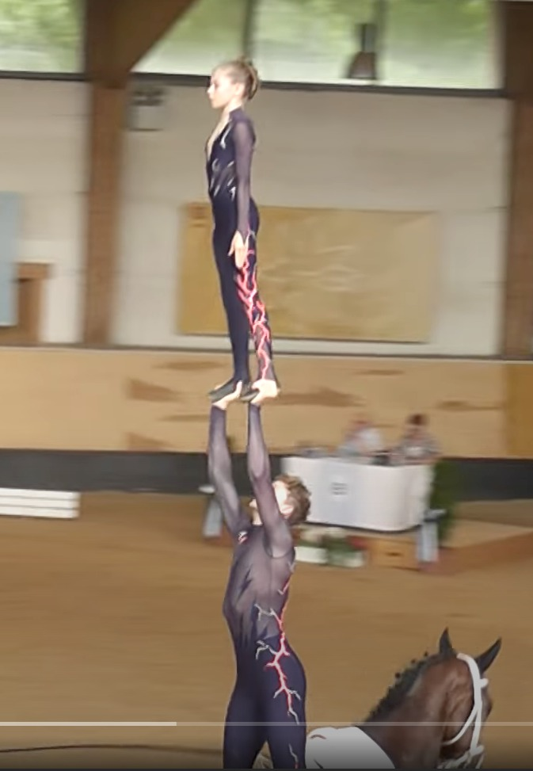
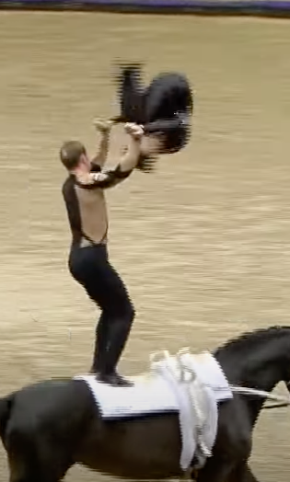
C2 - LEVELS - Squad/Pas de Deux
Level Exceptions - examples
Medium - CoG of flyer not extended as his potentiel maximum above the head of the Sup.V.
Upper - TOSS with CoG of the flyer extended as his potential maximum above the head of Sup.V. Upper - Hand to hand/feet with CoG of the flyer extended as his potential maximum above the head of Sup.V.
Low - CoG lower than the head Medium - CoG higher than the head
Medium - CoG lower than the head Upper - CoG higher than the head

Slide 33
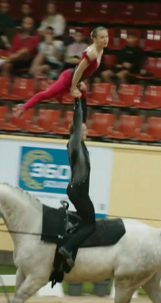
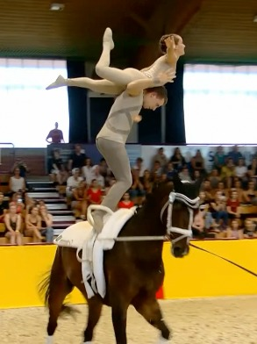
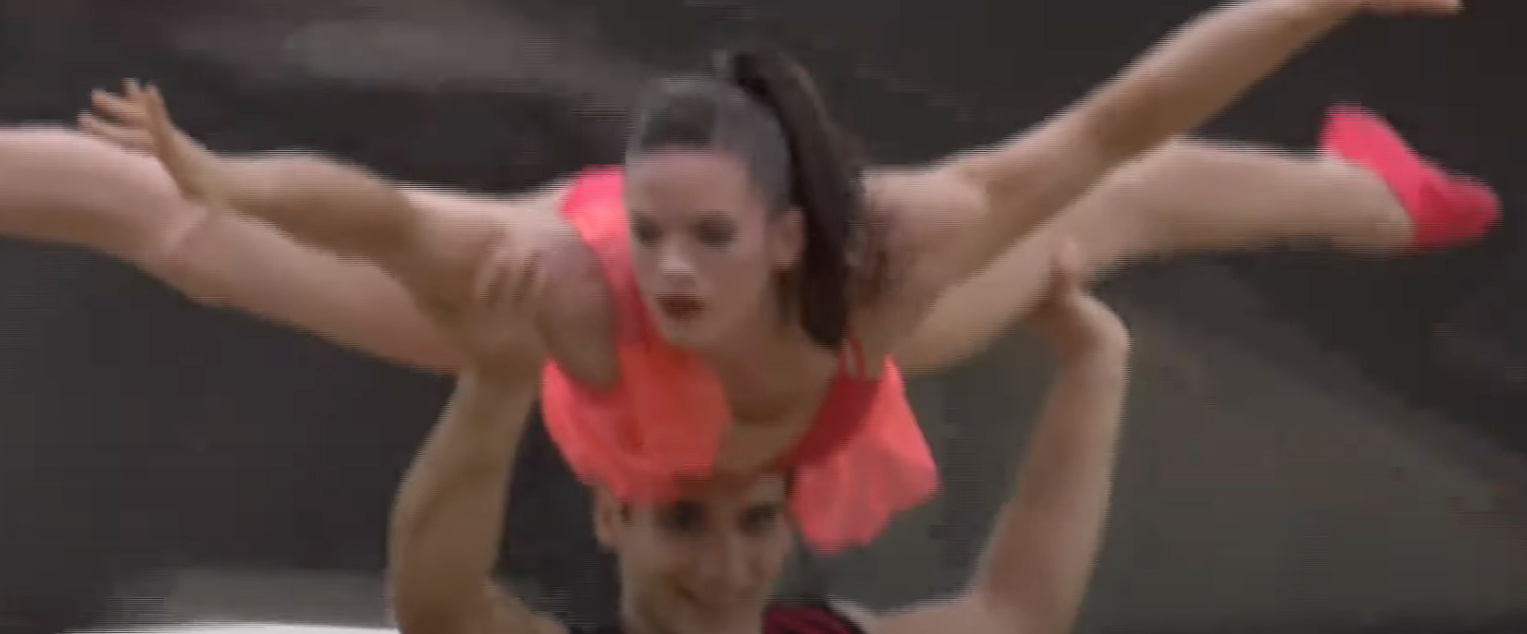
C2 - LEVELS - Squad/Pas de Deux
tricky levels examples
Medium - Not potential maximum Upper - Hand to hand/feet with CoG of the flyer extended as his potential maximum above the head of S.B.
Upper - PoC and CoG of the flyer not above the head of S.B
Aerial - PoC and CoG of the flyer not above the head of S.B
Upper - PoC and CoG of the flyer not above the head of S.B
Aerial - PoC and CoG of the flyer not above the head of S.B

Slide 34
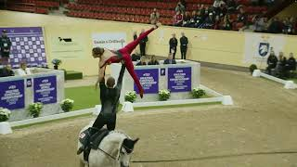
C2 - LEVELS - Squad/Pas de Deux
Video with Levels examples

Slide 35
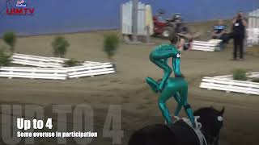
C2 - Participation in ROLES and Artistic Involvement
Reference scores Pas de Deux
Notes:
Up to 4 = 4
Up to 6 = 6
Up to 8 = 8
Up to 10 = 9

Slide 36
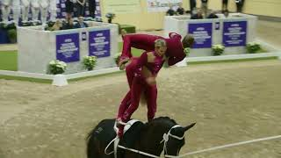
C2 - Participation of VAULTERS, Roles and Artistic Involvement
Scores test for Squad Same criteria as for PDD. We need to observe also participation of vaulters.

Slide 37
Unity of Composition - C3
Individuals/Squads/Pas de deux

Slide 38
CURRENT
GUIDELINES
2023

Slide 39
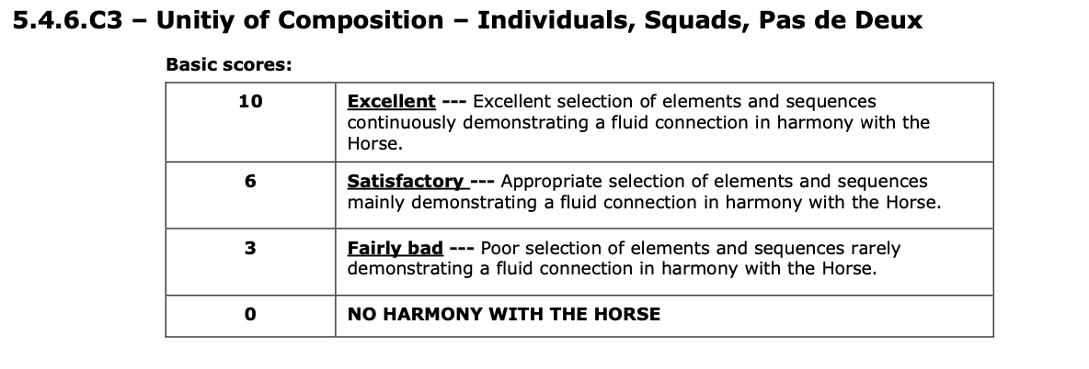
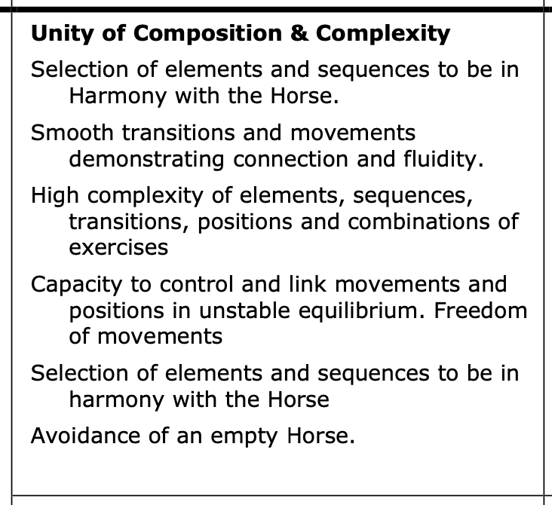
C3- Unity of Composition & Complexity 2023
Guidelines page 86
Scoresheets - Pas de Deux test 1 & 2

Slide 40
GUIDELINES
UPDATE
2024

Slide 41
C3 - Fluidity, Control, Connection, Complexity and FoM.
Goal/Context of C3
lepší popis 5 kritérií, ktoré musia rozhodcovia hodnotiť.
Kritériá majú priradenu štruktúru bodovania – „súlad s koňom“ z C3 bol presunutý v rámci CoH.
Pomôže rozhodcom, voltižérom a trénerom získať rovnaký pohľad na kompozíciu.
Vylepšite formulácia textu
5 kritérií:
Plynulosť
Kontrolal
Prepojenie (Dvojice/Skupiny)
Komplexnosť
Voľnosť pohybu (v Eng = FoM)

Slide 42
C3 - Flow, Control, Complexity, Connection, FoM - Definition
Updated text after Seminar in Salzburg

Slide 43
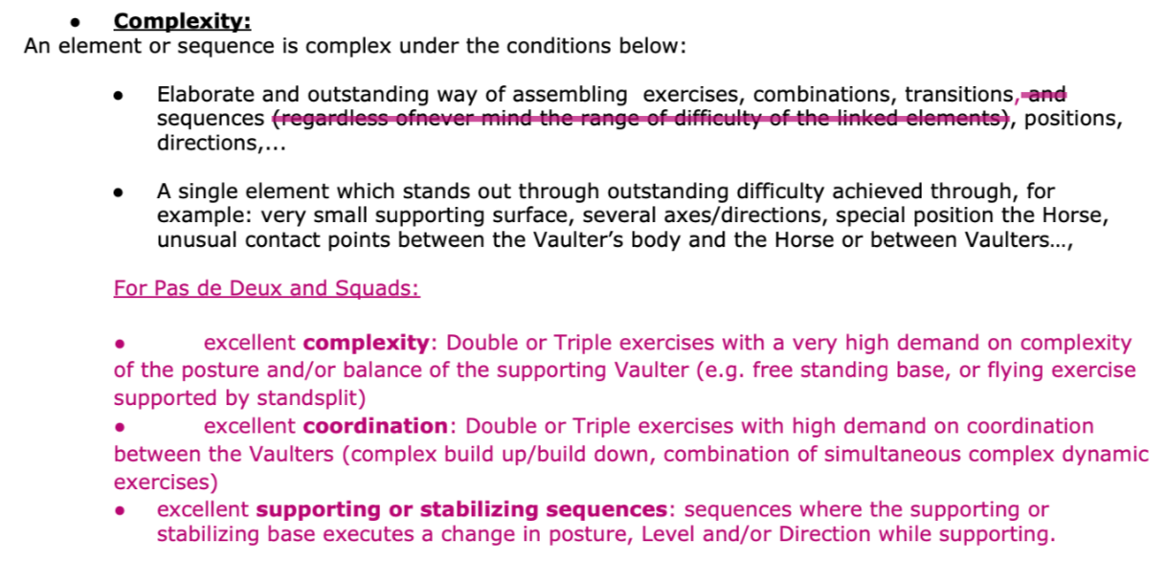
C3 - Flow, Control, Complexity, Connection, FoM - Definition
Updated text after Seminar in Salzburg

Slide 44
C3 - Flow, Control, Complexity, Connection, FoM - Definition
Updated text after Seminar in Salzburg

Slide 45
C3 - Complexity and Freedom of Movement - Definition
Removed from C1 (additional description for combinations complexity for Squad and Pas de Deux)
For an excellent Variety in Structure Complexity in Combination the following aspects are also considered:
- excellent complexity: Double or Triple exercises with a very high demand on complexity of the posture and/or balance of the supporting Vaulter (e.g. free standing base, or flying exercise supported by standsplit)
- excellent coordination: Double or Triple exercises with high demand on coordination between the Vaulters (complex build up/build down, combination of simultaneous complex dynamic exercises)
- excellent supporting or stabilizing sequences: sequences where the supporting or stabilizing base executes a change in posture, Level and/or Direction while supporting.

Slide 46
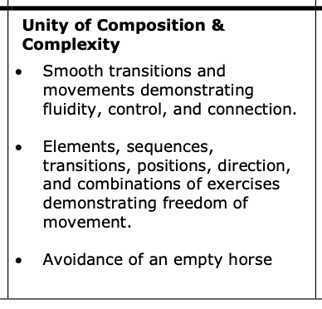
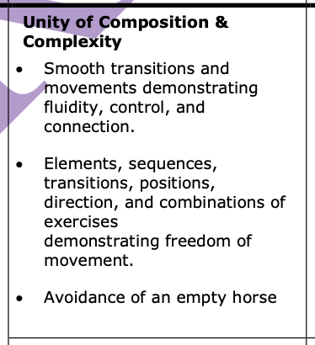
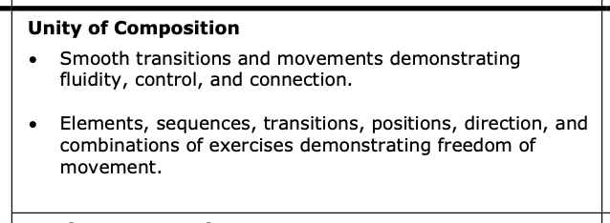
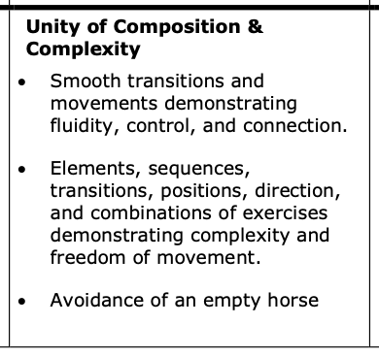
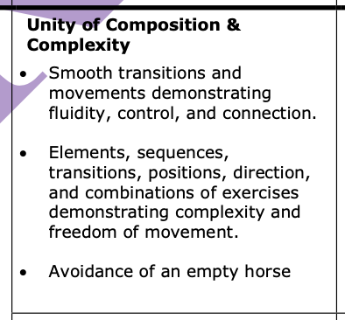
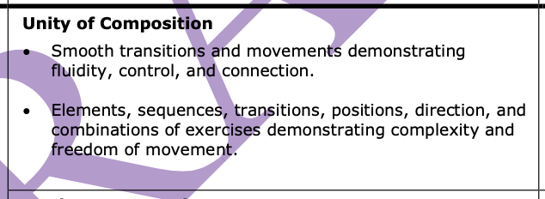
C3- Unity of Composition & Complexity - scoresheet (2024)
Squad test 1 = 1*
Pas de Deux test 1 = 1*
Ind. Test 1 = 1* CH, J, S,
never had complexity
Squad test 2 = 2* & 3*
Pas de Deux test 2 = 2*& 3*
Ind. Test 2 = CH, J,S,Yv 2* and S 3*
& complexity

Slide 47
C3- Flow, Control, Connection, Complexity and FoM Updated text after Seminar in Salzburg
Up to 10 Points - Reference score
✔ Flow:
Exercises are seamlessly connected creating an exemplary performance.
The vaulter(s) coordination and absorption of the canter flow and smoothness display lightness and a floating effect.
✔ Control:
Consistent control and skillful execution throughout the test.
The entire test is performed with a high level of safety.
✔ Complexity:
Excellent use of complex and creative positions, directions, exercises (including mounts and dismounts),
combinations, transitions and sequences. ✔ Freedom of movement:
o Distinctively creative, unique or unexpected use of space. Exercises are combined differently and cover various
directions, orientations and levels.
o The vaulter(s) move(s) unrestrained in balance. Voluntary and controlled moments of suspension between balanced moves.
o The distance with the handles varies and comes close to its potential maximum.
In Squad/Pas de Deux:
✔ Connection:
o Meaningful and creative connection between vaulters, who are united in a synergetic way.
o Individual excellence serves the Squad’s unity.
SHORT DESCRIPTION
Seamless test demonstrating lightness with a floating effect.
Consistent and skillful control throughout.
Excellent level of complexity.
Vaulter(s) are distinctively creative and move unrestrained with distance from the handles
Meaningful and creative connection for Squad and Pas de Deux.

Slide 48
C3- Flow, Control, Connection, Complexity and FoM Updated text after Seminar in Salzburg
SHORT DESCRIPTION
Well-connected test with moments of hesitation.
Elements are essentially controlled throughout the test.
Predominantly complex.
Vaulter(s) are creative and move(s) fairly unrestrained and with varying distance from the handles
Essentially well connected
for Squad and Pas de Deux.
Up to 8 Points - Reference score
➖ Flow:
Exercises are well connected. Good flow with moments of hesitation,
with minor lack of coordination or absorption of the canter flow and smoothness .
There is some lightness and a floating effect but not fully consistent throughout.
✔ Control:
All elements match the training level of the performing vaulter(s) and are essentially controlled.
The entire test is performed with a constant level of safety.
➖ Complexity:
Most of the time complex and creative positions, exercises (including mounts and dismounts), combinations, transitions and sequences are shown.
➖Freedom of movement:
o Creative or uncommon use of space. Exercises are combined differently and cover various directions, orientations, diagonals and levels.
o The vaulter(s) move(s) fairly unrestrained in balance. Voluntary and controlled moments of suspension between balanced moves.
The distance from the handles varies.
In Squad/Pas de Deux:
✔ Connection :
o Vaulters are essentially well connected, their interaction is meaningful, but not fully consistent.
o Individual excellence mostly serves the Squad’s unity.
In case of one fall with loss of contact and empty horse = 8 max. for C3.
(fall = 1a, 2a)
Notes:
HUN :the description of fluidity and control is also welcome, much clearer now, our only concern is that we do not think a judge is able to determine whether an exercise fits the competence and abilities of the vaulter (it could easily happen that they have the abilities but make mistakes), we think it is rather a competence of the coaches. We suggest focusing more only on the control element here, which can easily be seen, instead of guessing the competence levels

Slide 49
C3- Flow, Control, Connection, Complexity and FoM Updated text after Seminar in Salzburg
SHORT DESCRIPTION
Flow visible, but sometimes interrupted.
Several elements are not performed in a controlled way.
Occasionally complex.
Vaulter(s) are occasionally creative and mostly close to the handles
Connection with little synergy beyond just stabilizing and/or supporting. For squad and PdD
Up to 6 Points - Reference score
➖ Flow:
Sometimes interrupted by lack of adequate transitions or by laborious build ups/downs.
The vaulter(s) repeatedly show several a lack of coordination and/or absorption of the canter flow and smoothness in moves/transitions.
Flow is sometimes visible.
➖ Control:
Several elements do not match the training level of the performing vaulter(s) and/or are not performed in a controlled way.
Satisfactory level of safety.
➖ Complexity:
The vaulter(s) occasionally use(s) creative, positions, directions, exercises (including mounts and dismounts), combinations, transitions and sequences with an average complexity
➖ Freedom of movement:
o Occasionally creative use of space, position and/or direction and/or orientation and/or Level, during elements/exercices.
o The vaulter(s) mainly show(s) moves that can be performed in full balance, but without controlled moments of suspension between them.
o The Vaulter(s) is/are mostly close to the handles.
In Squad / Pas de Deux :
➖ Connection:
o Vaulters are disconnected on a few occasions, but they sometimes show some synergy beyond just stabilising and/or supporting each other.
o Basic interaction between vaulters.
o Individuality rarely serves the Squad’s unity.
In case of two or more falls with loss of contact and empty horse = 6 max. for C3
(fall=1a, 2a)

Slide 50
C3- Flow, Control, Connection, Complexity and FoM Updated text after Seminar in Salzburg
Up to 4 Points - Reference score
➖ Flow:
Repeatedly interruptions due to a lack of adequate transitions and laborious build ups/downs.
Lack of coordination and/or absorption of the canter flow and smoothness in moves/transitions.
Very few sequences show a sufficient flow.
➖ Control:
Many elements exceed the vaulter’s capabilities and/or medium to major lack of control.
Insufficient Level of safety begins to decreasing.
➖ Complexity:
No creative or complex positions, exercises (including mounts and dismounts), combinations, transitions and sequences.
➖ Freedom of movement:
o No creative use of space, basic position and/or orientation and/or direction and/or Level, during elements/exercices.
o The Vaulter(s) is/are always close to the handles.
In Squad / Pas de Deux :
➖ Connection:
o Insufficient quality and variety of connection with frequent interruptions.
o Vaulters mainly connected to stabilisze each other with a clear lack of synergy.
SHORT DESCRIPTION
Frequent interruptions.
Major Lack of control and insufficient level of safety begins to decreasing.
No complex elements.
No creativity, always close to the handles. and no creative use of space.
Insufficient quality and variety of connection.

Slide 51
C3- Flow, Control, Connection, Complexity and FoM Updated text after Seminar in Salzburg
Up to 2 Points - Reference score
➖ Flow:
No flow and smoothness , test constantly interrupted by lack of adequate move/transitions.
Very poor coordination and absorption of the canter.
Vaulter(s) constantly struggle(s).
➖ Control:
Elements not performed in a controlled way, affecting the Horse
Vaulter(s) over-taxed with the chosen exercises.
Clear lack of safety throughout.
➖ Complexity:
Only very basic positions, exercises (including mounts and dismounts), combinations, transitions.
➖ Freedom of movement:
o No creative use of space, very basic position and/or orientation and/or direction and/or Level, during elements/exercices.
o Constantly unbalanced and pulling on the handles throughout
In Squad / Pas de Deux :
➖ Connection:
No quality and no variety.
Vaulters are only connected to stabilisze each other, which they struggle to achieve.
SHORT DESCRIPTION
No fluidity,constant interruptions.
Elements are not controlled and affect the horse. Clear lack of safety throughout.
Only very basic elements.
No creativity and constantly unbalanced and pulling on the handles throughout
Vaulters constantly struggle to stay connected.

Slide 52
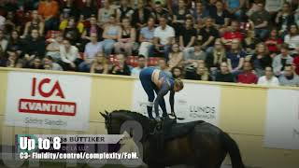
C3 - Individual
Reference scores Individual

Slide 53
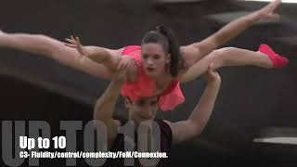
C3 - Pas de deux
Reference scores Pas de Deux

Slide 54
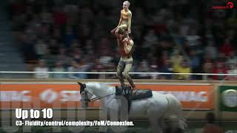
C3 - Squad
Reference scores Squad

Slide 55
ĎAKUJEM
Oct 21, 2022

